Slide 1
COST-EFFECTIVE SOLUTION IP LAST MILE MONITORING
Presentation
V1.0

Slide 2
PROFESSIONAL IP LAST MILE MONITORING
COMPACT DESIGN
MULTIPLE STANDARDS
PROFESSIONAL USE

Slide 3
Main
features
Gsertel's GProbe10 is a cost-effective IP last mile probe that allows remote and real-time IP signal monitoring

Slide 4
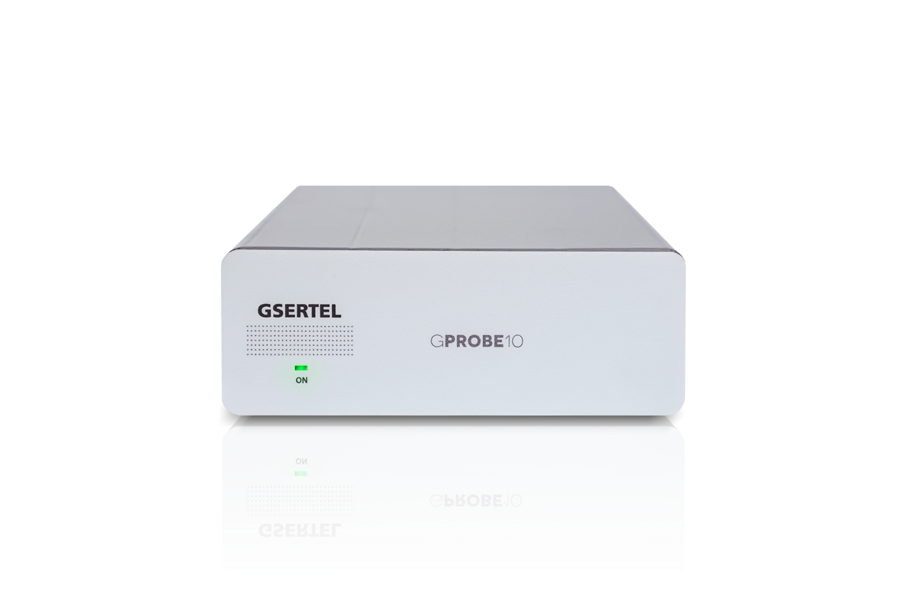
Main features
IP Analysis
Complete analysis of the IP signals
Maximum and minimum arrival interval between packets in one second
IP and UDP payload bitrate
Media loss rate and loss IP frame
Multiple IP flows in parallel (up to 64)
IP Jitter
UDP and RTP modes (auto)

Slide 5
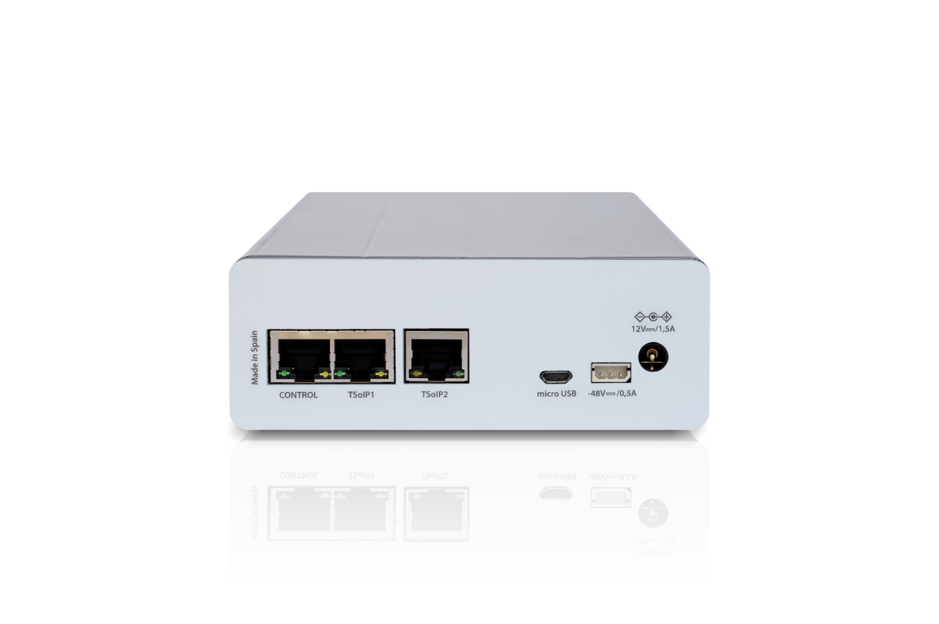
Main features
And much more…
Alarms: level 1 and level 2 priority errors
Configurable type of alarm
(Info, Warning, Error)
HTML5 control application
SNMP control
Ethernet connectivity
Internal storage: 20MB
External storage: USB port

Slide 6
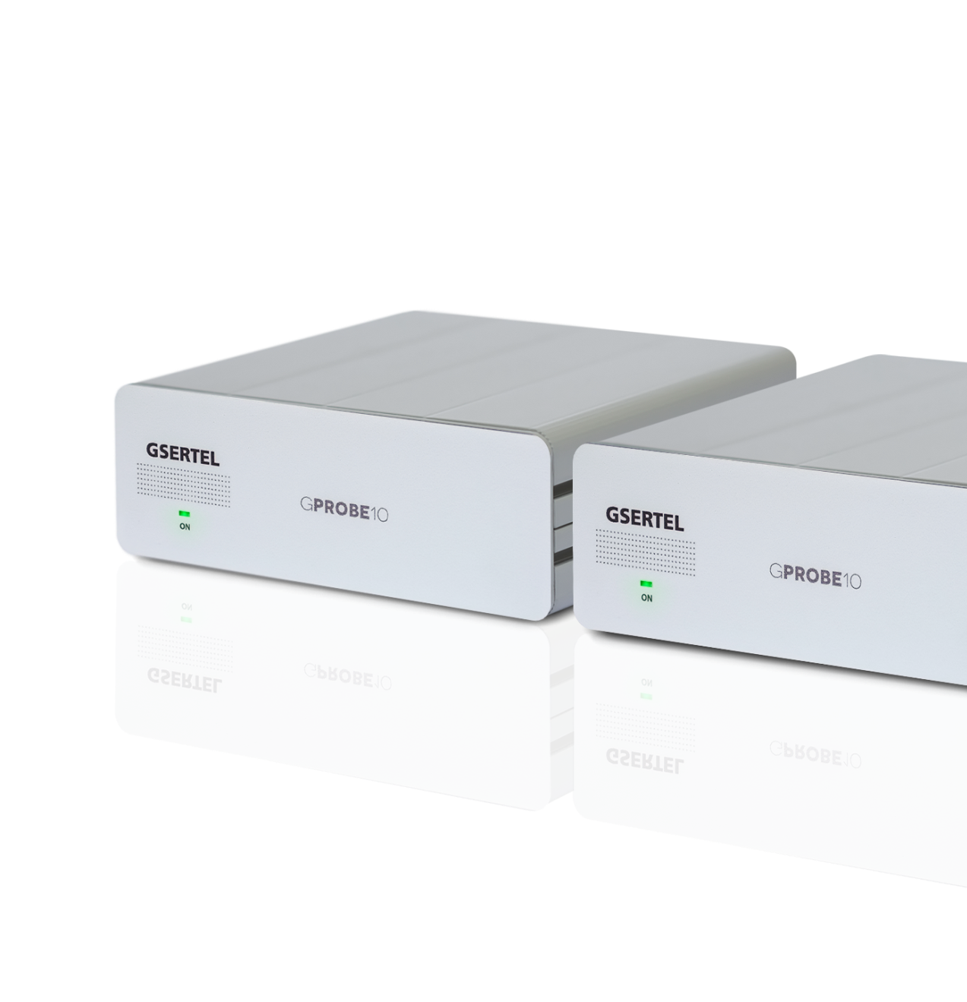
Main features
Optional features
Additional IP flows in parallel
(16 additional flows each license)
Level 3 priority errors alarms
1 x RF 75Ω
(DVB-T/T2, ISDB-T/Tb, QAM or DVB-S/S2)
Power supply -48VDC
Rack adapter

Slide 7
Web
Application
HTML5 control application
Intuitive interface
You only need a standard browser
All the measurements at a glance
User configurable alarms
Setup your GProbe10

Slide 8
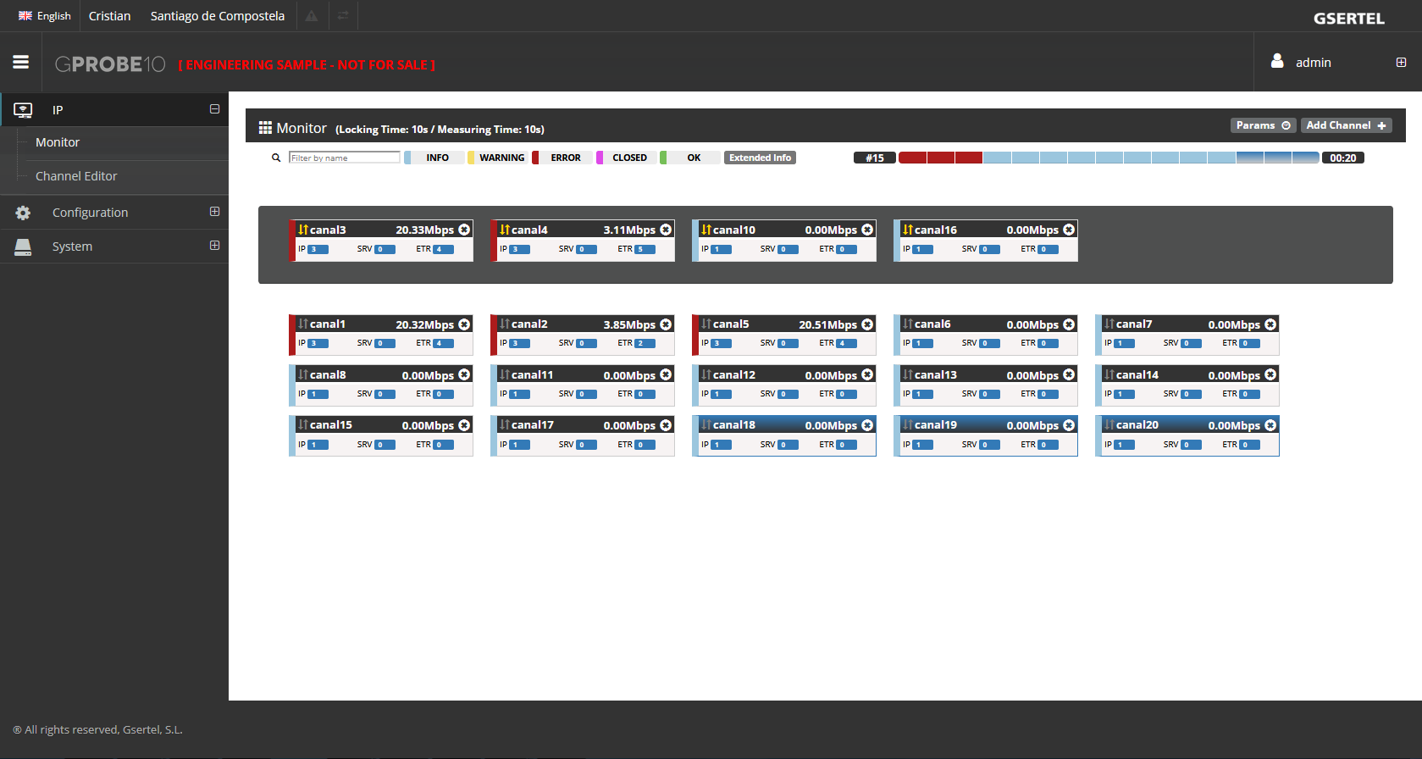
Web application
Monitor
This feature allows to review at a glance the status of all the IP channels that the user selected to check.
You can see the bitrate and the alarms of each channel

Slide 9
Web application
Monitor
continuous monitoring
The grey shaded zone contains the continuous monitoring channels

Slide 10
Web application
Monitor
polling
The white zone contains the polling channels

Slide 11
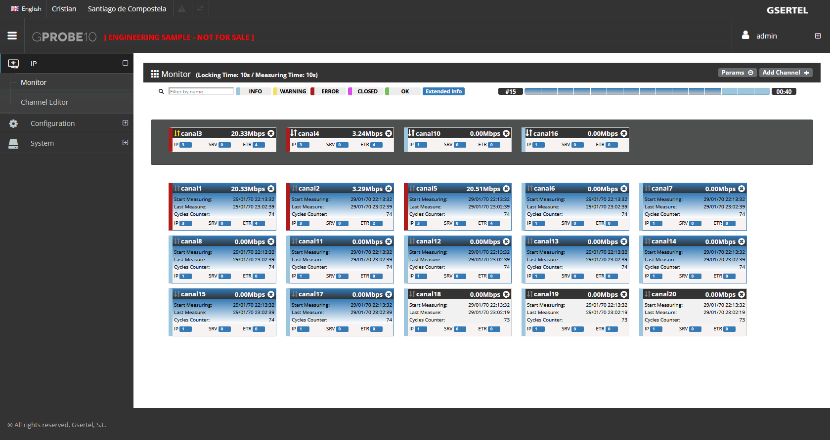
Web application
Monitor
extended info
Shows a more detailed information of each channel

Slide 12
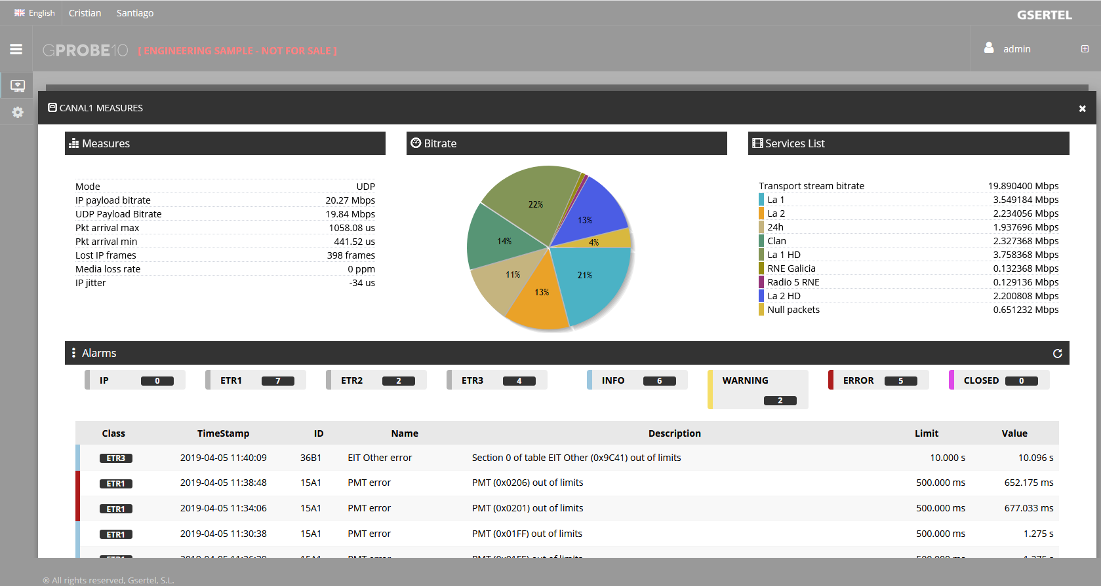
Web application
Monitor
channel card
Shows all the information and measurements of the selected channel:
Measurements
Services pie chart with the occupation of each service
Services list with bitrates
List of alarms

Slide 13
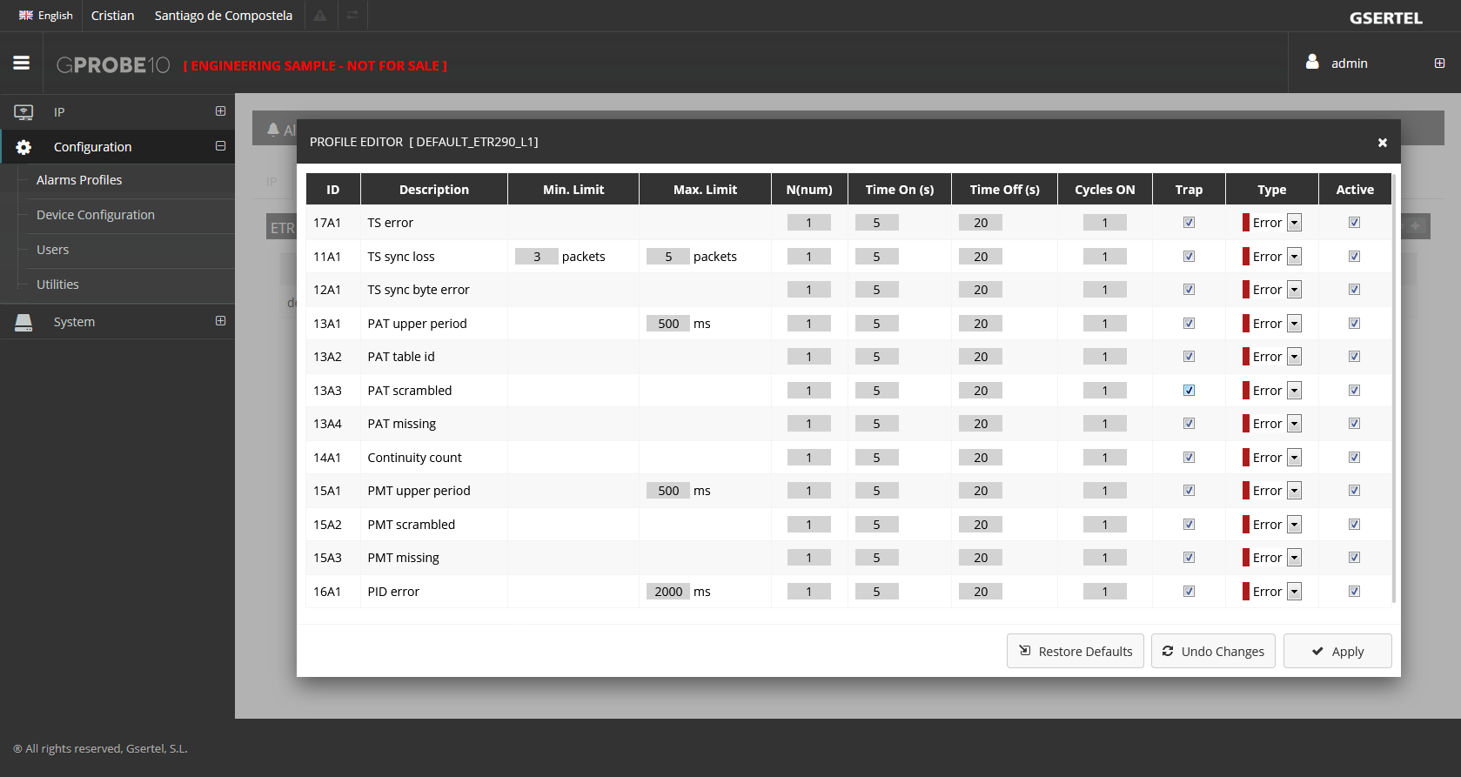
Web application
Alarms
The user can create as many alarms profiles as he wants.
The alarms os each profile are configured separately

Slide 14
Contact us
www.gsertel.com
info@gsertel.com
+ 34 981 522 447
Volta do Castro s/n - E15706 Santiago de Compostela · A Coruña

